Slide 1



Email Etiquettes
Prepared by:
Archana Kumari
Rajat Pathak
Bikash Sahoo
Md. Rihan
Date : 23 Oct 2024

Slide 2
Overview
01
05
01
Introduction
05
Proofreading
02
Why Email Etiquette Matters
06
Replying to Emails
03
Best Practices for Writing a Professional Email
07
Common Mistakes to Avoid
03
04
Writing the Email Body
08
Conclusion

Slide 3
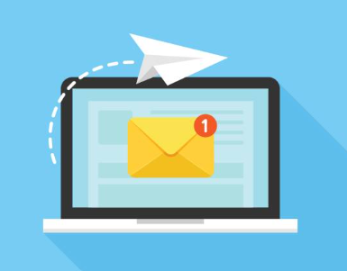
Introduction
What is an E-mail?
Email, short for electronic mail, is a method of exchanging messages between individuals using electronic devices. It facilitates quick and efficient communication across distances, making it an essential tool in both personal and professional settings.
What is Email Etiquette?
Email etiquette refers to the established guidelines and best practices for communicating effectively and professionally via email. It promotes clear efficient communication. It builds positive professional image. It ensures mutual respect in business settings.

Slide 4
Why Email Etiquette Matters?
Clear and Effective Communication: Email etiquette ensures that our messages are conveyed clearly and effectively, significantly reducing the chances of miscommunication and misunderstandings.
Time-Saving: Well-structured emails with clear subject lines and concise content enable recipients to quickly grasp the email's purpose, saving time for both the sender and receiver.
Respect and Courtesy: Adhering to email etiquette reflects respect and courtesy towards the recipient, which is crucial for fostering strong relationships and maintaining a positive professional reputation.
Supporting Business Objectives: Effective email etiquette is vital for achieving key business goals, such as nurturing customer relationships, generating leads, and successfully closing deals.

Slide 5
Best Practices for Writing a Professional Email
Subject Line:
Be brief and concise.
Ensure it reflects the content of the email.
Avoid vague or generic phrases.
Refrain from using ALL CAPS or excessive punctuation.
e.g., Invitation: Trainees- Presentation @ Wed 23 Oct 2024 11am - 12pm (IST)
Salutations:
Begin with a formal greeting such as Respected Sir and in some scenario we can use "Dear [Recipient's Name]" or "Hello [Recipient's Name]."
Steer clear of informal greetings like "Hi" or "Hey".
When in doubt, use the title (Mr./Ms.) to show respect.

Slide 6
Best Practices for Writing Professional Email
Body:
Clearly state the purpose of the email in the first paragraph.
Keep the content concise and to the point, avoiding unnecessary details.
Use simple and clear language, avoiding jargon or technical terms unless necessary.
Break up long paragraphs into shorter ones for easier reading.
Closing & Signature:
Use professional closings such as "Regards" or "Thank You".
Avoid using overly casual or informal closings.
Include a clear and complete signature with your name, title and contact information.
Consider adding a disclaimer or confidentiality notice if necessary.

Slide 7
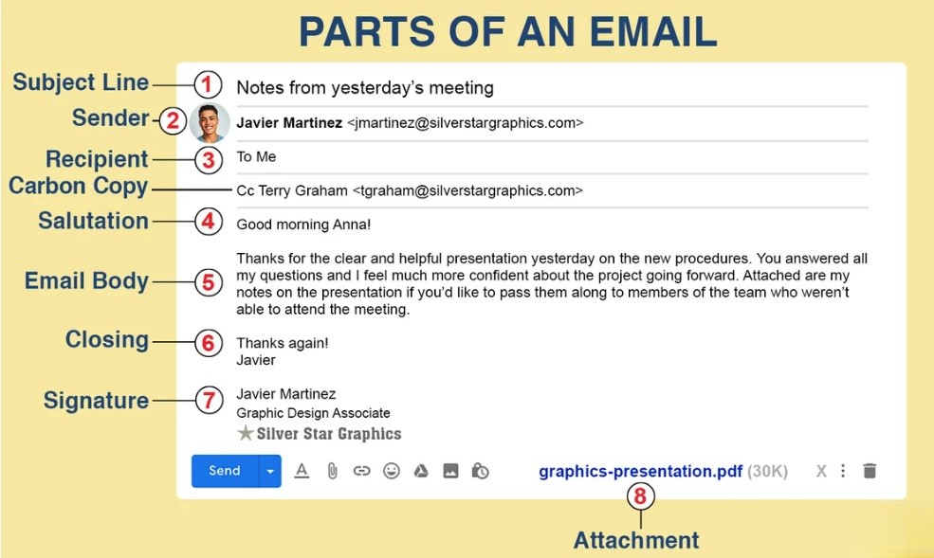

Slide 8
Example
Poorly written Email:
Subject: Meeting
Hi,
Send the latest files for the project. Let me know when you can meet.
Thx,
Rohan
Well-Written Email:
Subject: Request for Latest Project Files & Meeting
Hi [Name],
Could you please send me the latest project files by Friday? I'd also like to schedule a meeting next week to discuss progress. Let me know when you're available.
Thanks,
Rohan

Slide 9
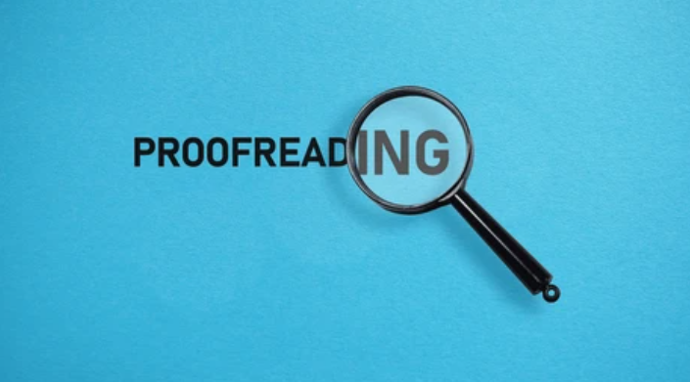
Proofreading
Check for spelling, grammar, and punctuation errors.
Review for clarity, coherence, and consistency.
Ensure accuracy of facts, dates, and names.
Read the email out loud to catch any awkward phrasing.
Get someone else to review the email if possible.

Slide 10

Replying to Emails
Before Replying:
Take a moment to read and understand the original email.
Consider the tone and content of the original email.
Gather any necessary information or resources before responding.
When Replying:
Respond promptly, ideally within 24 hours.
Keep your response brief and to the point.
Use proper grammar, spelling, and punctuation.
Be respectful and professional in your tone.

Slide 11
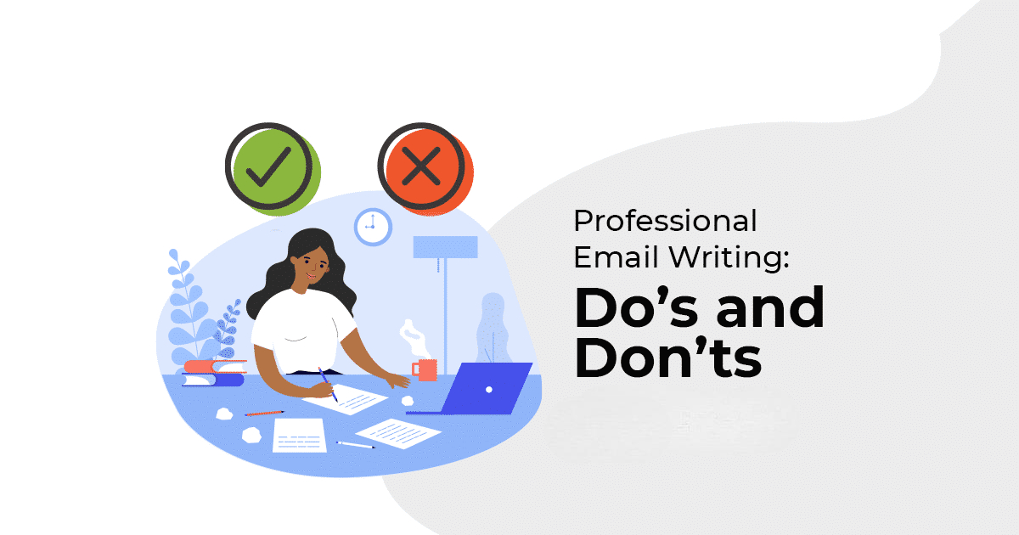
Common Mistakes to Avoid
Ignoring the subject line
Forgetting to proofread
Overusing Reply All
Do not Forget the Conversation Closer
Missing attachments
Inappropriate tone
Be mindful of time zone differences for
international recipients.

Slide 12
Conclusion
Proofread and edit your email before sending it.
Use a professional font and font size.
Avoid emailing outside the organization.
Always be respectful and mindful of tone.
Avoid long, unstructured emails.

Slide 13
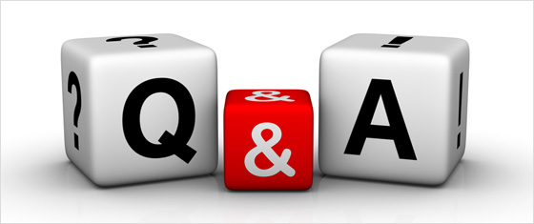
Thank You!

